Slide 1
Commute Trip Reduction: 2023-25 Data Review
Survey responses and worksite amenities
TDM Technical Committee / TDM Executive Board Joint Meeting
July 2, 2026
Kendra Trachta, WSDOT Data Analyst

Slide 2
Commute Trip Reduction (CTR)
Washington state program to reduce single-occupancy vehicle commutes
Established as part of Washington’s Clean Air Act to reduce pollution and traffic congestion
Affected worksites encourage employees to use alternative commute modes
Biannual surveys of employee commute choices provide data to assess the impact of the CTR program

Slide 3
Today we’ll review:
Summaries of 2023-2025 CTR survey responses
Amenities and incentives available at worksites
Connections between drive alone rates (DAR) and worksite amenities
Ongoing improvements in collection, management, and communication of CTR data

Slide 4
Scope of 2023-2025 data:
Survey data
1,108 worksites participated in the 2023-2025 survey
227,165 survey responses were validated
225,088 survey responses with one-way commute distances of 150 miles or less are included in today’s presentation
Program data
Most Seattle worksites do not have program data in the CTR Tool (yet!)
577 worksites have both program data and survey data available; these are included in today’s presentation
Survey response rate
A program-wide response rate cannot be calculated; the number of employees per worksite is in the program data
Among the 577 worksites with both program data and survey data, the survey response rate was 32%
Today’s presentation will not match the CTR Tool dashboard!
Notes:
3,981 survey responses excluded by criteria

Slide 5
Traffic reduction benefits weekly
Single-occupancy commutes
Potential single-occupancy commutes weekly: 1,225,500
Adjusted single-occupancy commutes weekly: 585,000
Single-occupancy commutes avoided weekly: 640,000
Drive alone rate among survey respondents: 47 %
Roundtrip single-occupancy commute miles
Potential roundtrip single-occupancy miles commuted weekly: 38,511,192
Adjusted roundtrip single-occupancy miles commuted weekly: 17,895,427
Roundtrip single-occupancy commute miles avoided weekly: 20,615,765

Slide 6
Environmental & consumer benefits weekly
Cleaner air
  8,100 metric tons / 17,780,000 pounds of CO2 emissions avoided weekly
Cleaner water
  0.04 metric tons / 91 pounds of PM2.5* from brake wear avoided weekly
  0.02 metric tons / 44 pounds of PM2.5* from tire wear avoided weekly
Consumer savings
  928,000 gallons of gasoline saved weekly
  $3,062,000.00 consumer dollars saved on gasoline weekly
*PM2.5 refers to particulate matter equal to or smaller than 2.5 micrometers in diameter
Calculations are based on measures from:
U.S. Bureau of Transportation Statistics’ Estimated U.S. Average Vehicle Emissions Rates per Vehicle by Vehicle Type Using Gasoline, Diesel, and Electric
U.S. Environmental Protection Agency’s Tailpipe Greenhouse Gas Emission from a Typical Passenger Vehicle
U.S. Energy Information Administration’s Analysis of U.S Retail gasoline prices

Slide 7
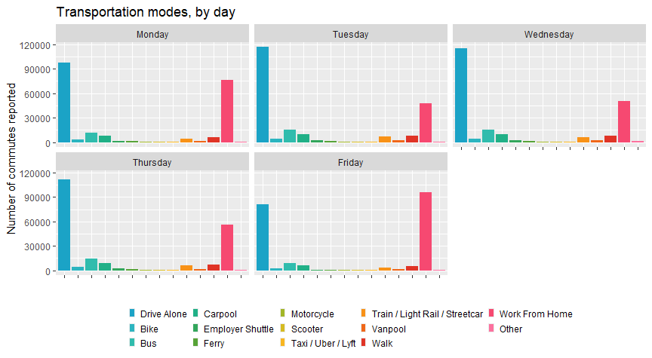
Commute modes

Slide 8
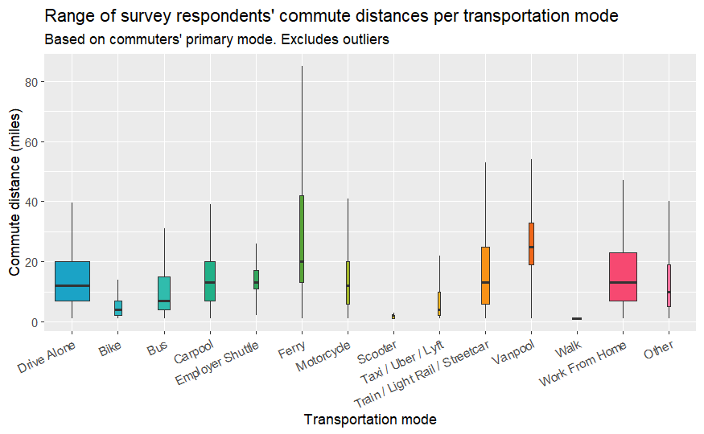
Commute distances
Notes:
Width indicates number of commutes via the mode
Vertical line indicates quartiles of commute distances by mode

Slide 9
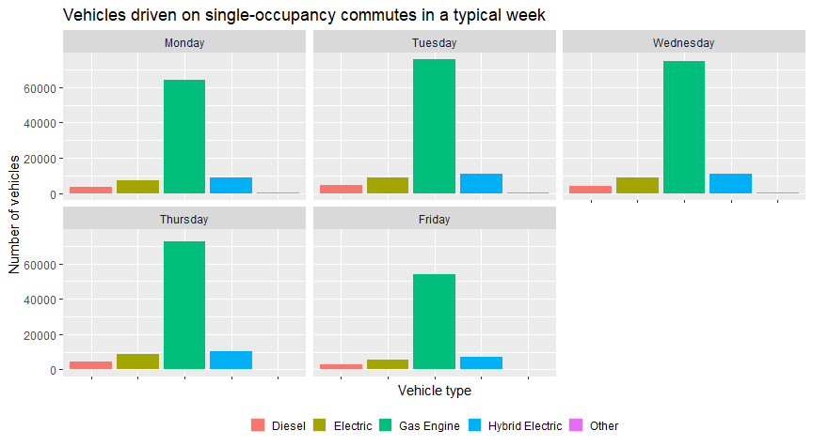
Single-occupancy vehicle types

Slide 10
DAR and Worksite amenity comparisons
Factors that may affect commuter behavior:
Onsite amenities provided by the worksite
Local features available within one-quarter mile of the worksite
Miscellaneous incentives to reduce single-occupancy commutes
Guaranteed ride home programs
Employee use of company vehicles
Notes for the following slides:
Simple comparisons do not identify causal relationships!
The following comparisons exclude Seattle worksites
Analysis contains only the 577 worksites with both program data and survey data in the CTR Tool

Slide 11
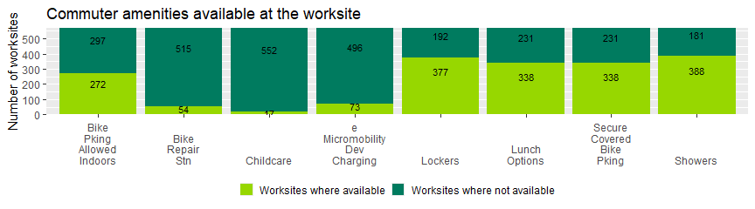
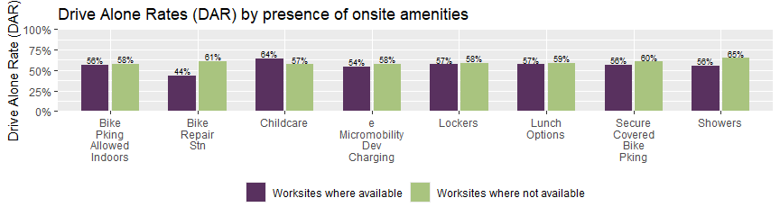
Worksite amenities

Slide 12
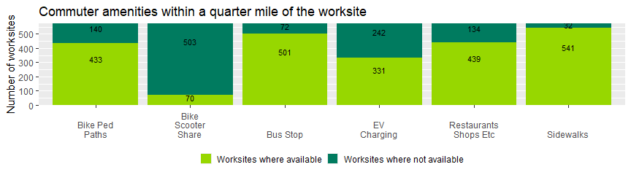
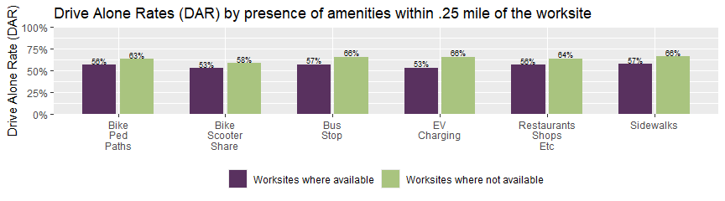
Local features

Slide 13
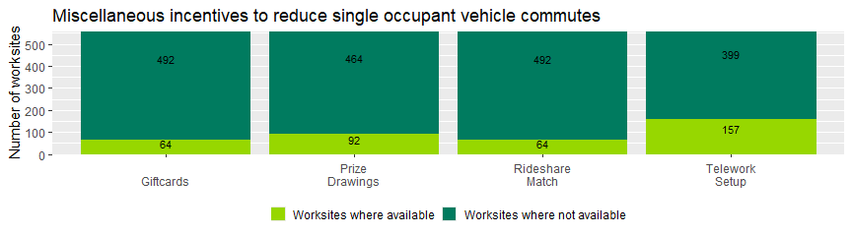
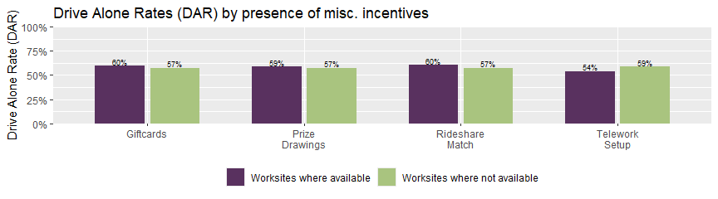
Miscellaneous incentives

Slide 14
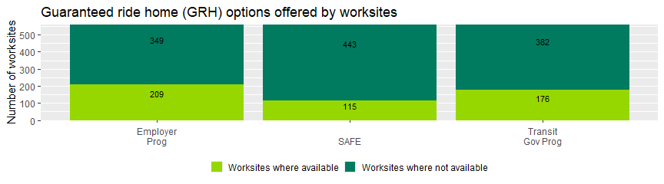
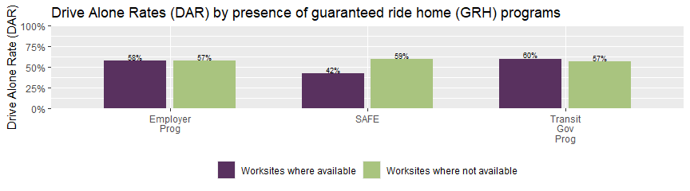
Guaranteed ride home options

Slide 15
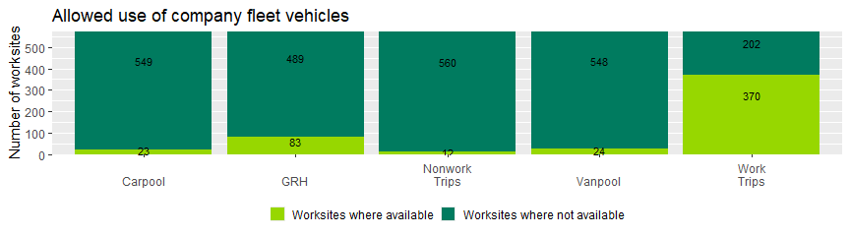
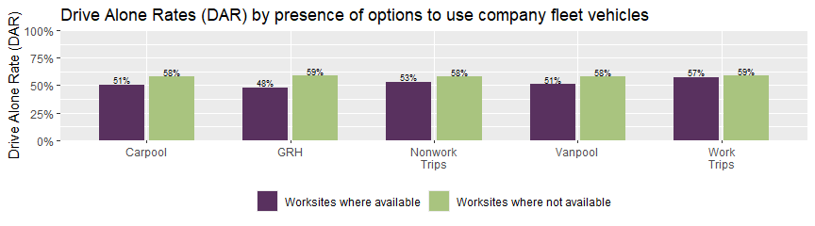
Use of company vehicles

Slide 16
What’s next?
Ongoing CTR Tool improvements
  Clarifying dashboard measures
  Cleaning data (commute origins, commute distance, modes, etc.)
  Aligning all calculations
  Improving quality of data collection
  Documenting definitions, formulas, and processes
Integrating Seattle worksites’ data, past and future
Exploring potential annual report for implementers and ETCs

Slide 17
Thank you!

Slide 18
Commute modes: # daily
Commutes by transportation mode in a typical week
Transportation mode | Monday | Tuesday | Wednesday | Thursday | Friday | Saturday | Sunday
Drive Alone | 97,944 | 116,904 | 115,372 | 111,683 | 81,280 | 16,360 | 14,849
Bike | 3,392 | 4,510 | 4,299 | 4,255 | 2,751 | 385 | 331
Bus | 11,790 | 15,345 | 15,060 | 14,472 | 9,005 | 1,245 | 1,090
Carpool | 7,821 | 10,205 | 9,769 | 9,193 | 5,847 | 1,039 | 972
Employer Shuttle | 1,706 | 2,762 | 2,545 | 2,516 | 916 | 35 | 32
Ferry | 1,226 | 1,636 | 1,669 | 1,523 | 947 | 120 | 132
Motorcycle | 768 | 950 | 964 | 940 | 792 | 198 | 184
Scooter | 441 | 509 | 531 | 488 | 369 | 89 | 80
Taxi / Uber / Lyft | 492 | 693 | 674 | 666 | 443 | 135 | 140
Train / Light Rail / Streetcar | 4,592 | 6,570 | 6,450 | 6,236 | 3,543 | 514 | 472
Vanpool | 1,820 | 2,315 | 2,156 | 2,034 | 1,221 | 110 | 104
Walk | 6,518 | 7,780 | 7,800 | 7,462 | 5,594 | 1,114 | 1,060
Work From Home | 76,296 | 47,920 | 50,625 | 55,669 | 96,276 | 4,925 | 4,441
Other | 928 | 1,015 | 1,040 | 1,067 | 1,063 | 470 | 465
Day Off | 8,115 | 4,491 | 4,607 | 4,904 | 11,420 | 194,344 | 196,908

Slide 19
Commute modes: % daily
Commutes by transportation mode in a typical week, percent per day
Transportation mode | Monday | Tuesday | Wednesday | Thursday | Friday | Saturday | Sunday
Drive Alone | 43.8% | 52.3% | 51.6% | 50.1% | 36.7% | 7.4% | 6.7%
Bike | 1.5% | 2.0% | 1.9% | 1.9% | 1.2% | 0.2% | 0.1%
Bus | 5.3% | 6.9% | 6.7% | 6.5% | 4.1% | 0.6% | 0.5%
Carpool | 3.5% | 4.6% | 4.4% | 4.1% | 2.6% | 0.5% | 0.4%
Employer Shuttle | 0.8% | 1.2% | 1.1% | 1.1% | 0.4% | 0.0% | 0.0%
Ferry | 0.5% | 0.7% | 0.7% | 0.7% | 0.4% | 0.1% | 0.1%
Motorcycle | 0.3% | 0.4% | 0.4% | 0.4% | 0.4% | 0.1% | 0.1%
Scooter | 0.2% | 0.2% | 0.2% | 0.2% | 0.2% | 0.0% | 0.0%
Taxi / Uber / Lyft | 0.2% | 0.3% | 0.3% | 0.3% | 0.2% | 0.1% | 0.1%
Train / Light Rail / Streetcar | 2.1% | 2.9% | 2.9% | 2.8% | 1.6% | 0.2% | 0.2%
Vanpool | 0.8% | 1.0% | 1.0% | 0.9% | 0.6% | 0.0% | 0.0%
Walk | 2.9% | 3.5% | 3.5% | 3.3% | 2.5% | 0.5% | 0.5%
Work From Home | 34.1% | 21.4% | 22.7% | 25.0% | 43.5% | 2.2% | 2.0%
Other | 0.4% | 0.5% | 0.5% | 0.5% | 0.5% | 0.2% | 0.2%
Day Off | 3.6% | 2.0% | 2.1% | 2.2% | 5.2% | 87.9% | 89.0%

Slide 20
Commute distances by mode
Commute distances in miles by transportation mode (outliers excluded)
Transportation mode | Number of commutes | Minimum commute | Median commute | Average commute | Maximum commute
Drive Alone | 500,334 | 1 | 12 | 13.4 | 39.5
Bike | 18,169 | 1 | 4 | 4.8 | 14.0
Bus | 63,008 | 1 | 7 | 9.2 | 31.0
Carpool | 41,006 | 1 | 12 | 13.8 | 39.0
Employer Shuttle | 9,987 | 2 | 13 | 13.7 | 26.0
Ferry | 6,756 | 1 | 20 | 27.8 | 85.0
Motorcycle | 4,245 | 1 | 12 | 13.2 | 41.0
Scooter | 1,922 | 1 | 1 | 1.5 | 3.0
Taxi / Uber / Lyft | 2,861 | 1 | 4 | 5.8 | 22.0
Train / Light Rail / Streetcar | 26,996 | 1 | 13 | 16.3 | 53.0
Vanpool | 9,065 | 1 | 24 | 24.9 | 54.0
Walk | 26,896 | 1 | 1 | 1.0 | 1.0
Work From Home | 304,868 | 1 | 12 | 14.5 | 47.0
Other | 4,720 | 1 | 9 | 11.4 | 40.0

Slide 21
Single-occupancy commutes by vehicle type
Vehicles driven on single-occupancy commutes in a typical week
Vehicle type | Monday | Tuesday | Wednesday | Thursday | Friday
Diesel | 3,722 | 4,422 | 4,274 | 4,225 | 3,093
Electric | 7,146 | 8,915 | 8,679 | 8,505 | 5,552
Gas Engine | 64,095 | 75,904 | 74,943 | 72,576 | 54,001
Hybrid Electric | 8,969 | 10,977 | 10,862 | 10,416 | 7,267
Other | 269 | 310 | 317 | 311 | 248

