Slide 1

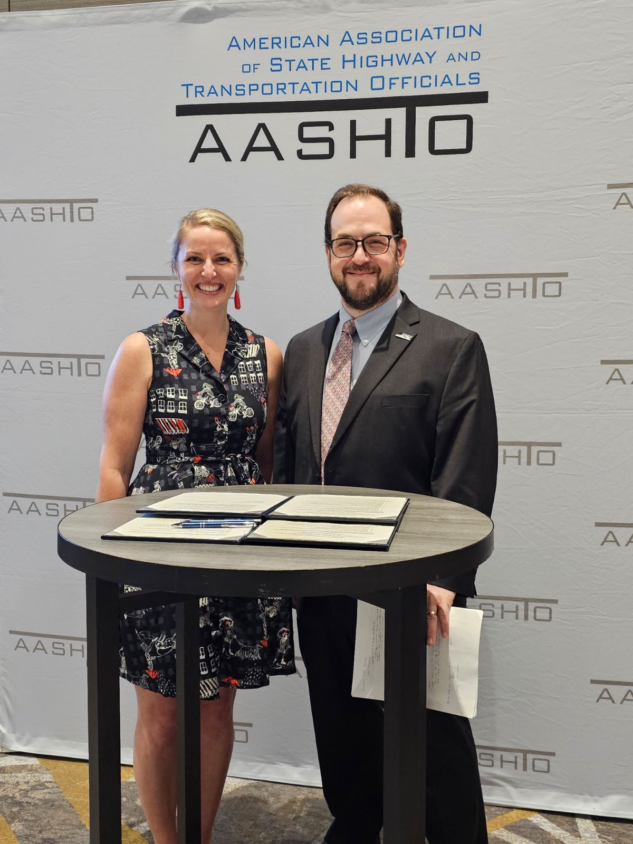
Tdm ACROSS THE United states
Veronica Jarvis
Senior Planner
Thurston Regional Planning Council

Slide 2

What is TDM?
Transportation Demand Management (TDM) = strategies to inform and encourage travelers to maximize efficiency of the transportation system
Outcomes: improved mobility, reduced congestion, lower vehicle emissions
Activity: TDM is behavior change.
Notes:
Definition (ACT / actweb.org): TDM is the use of strategies to inform and encourage travelers to maximize the efficiency of a transportation system leading to improved mobility, reduced congestion, and lower vehicle emissions. Source: https://www.actweb.org/what-is-tdm/
Facilitation note: I want to do the arm crossing exercise to demonstrate behavior change.

Slide 3
Examples of TDM at DOTs
Competitive grant programs (TDM + multimodal)
Innovation grants (new programs, TMA/TMO support)
Technical assistance + public awareness
Employer-based requirements and compliance support
State grant programs delivered through MPOs/transit agencies

Slide 4

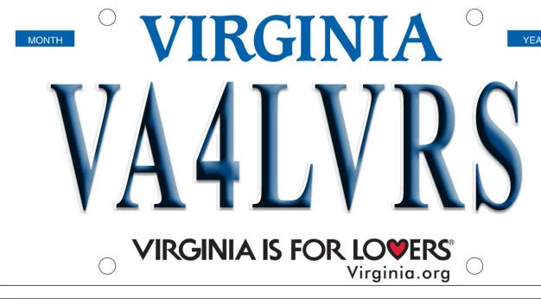
Virginia DOT (DRPT) – Commuter Choice Program
Uses express lane toll revenues to fund a competitive grant program.
Funds TDM and multimodal projects benefiting corridor users.
Notes:
https://drpt.virginia.gov/our-grant-programs/cap/

Slide 5
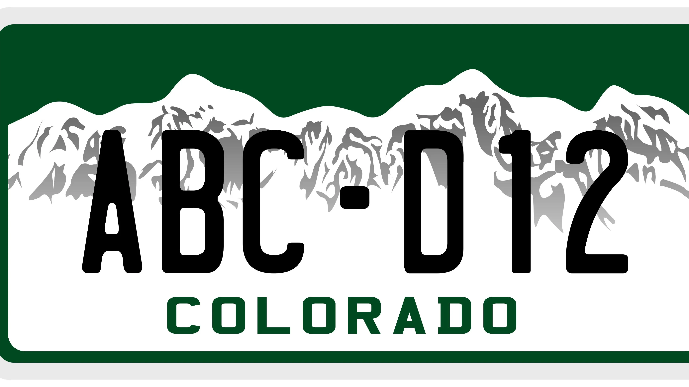
Colorado DOT – Innovative Mobility TDM Grants
Funding support for innovative new programs
Supports Transportation Management Organization capacity
Also: TDM requirements before highway widening projects.
Notes:
https://www.codot.gov/programs/innovativemobility/grants
https://www.codot.gov/programs/innovativemobility/mobility-services/tdm
https://www.codot.gov/programs/environmental/greenhousegas

Slide 6
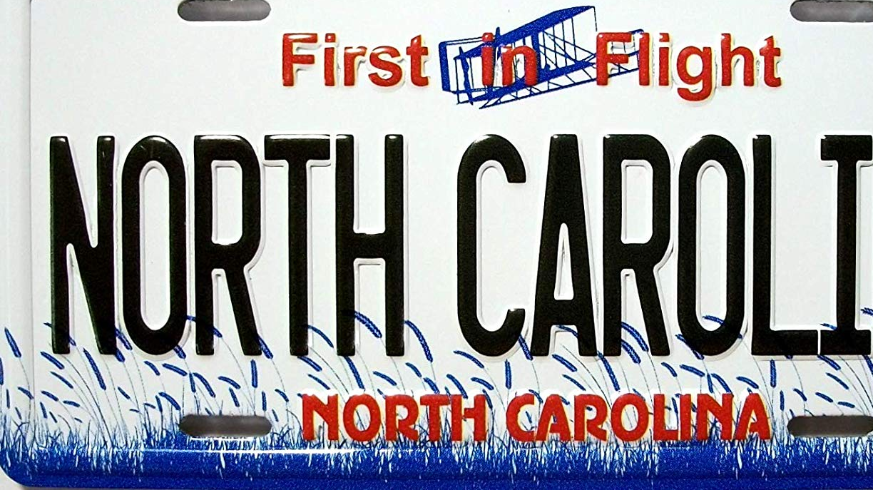
North Carolina – TDM grants + technical assistance
TDM funds support technical assistance and public awareness
Annual grant program to support initiatives statewide
Notes:
https://connect.ncdot.gov/business/Transit/Pages/TDM.aspx#:~:text=The%20North%20Carolina%20Department%20of%20Transportation's%20(NCDOT),Compressed%20work%20weeks%20*%20Parking%20policies/pricing%20structures
Example: Go Triangle in Raleigh Durham research triangle https://gotriangle.org/

Slide 7
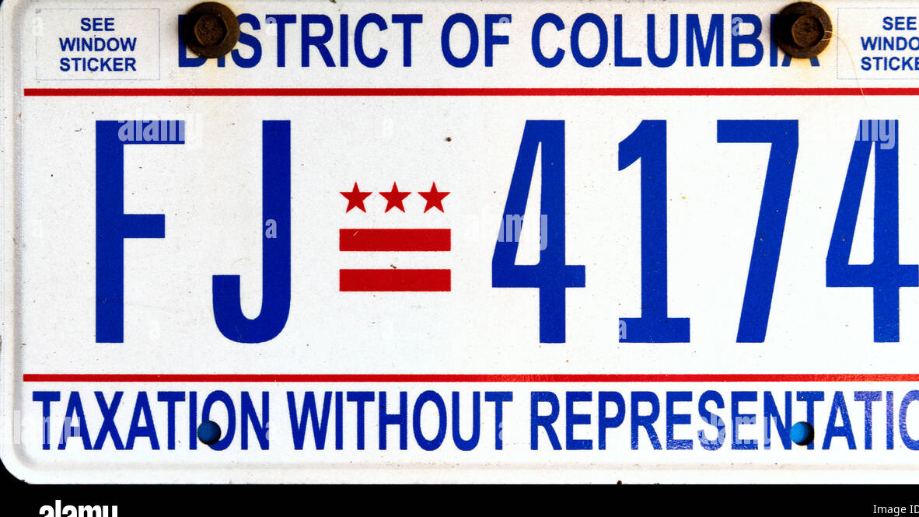
DDOT – goDCgo program
Strong employer-focused TDM program, and residential, school, large events TDM programming.
Compliance resources and support for employer requirements (e.g., Parking Cashout reporting)
Notes:
https://godcgo.com/

Slide 8
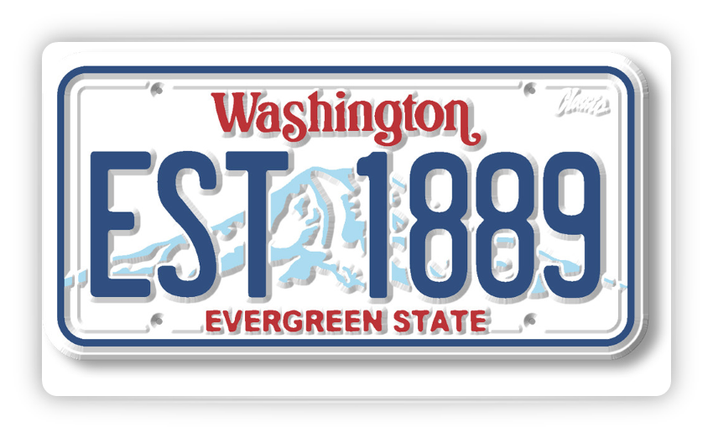
WSDOT – TDM grant program (Also the best program)
State TDM grant program with MPOs, TMAs, and transit agencies as grantees (many use CMAQ to supplement programs).
Supports transit, carpool/vanpool, walk/bike, and telework programs
The state DOT provides the framework and funding, and each community tailors the program to their region-we love to share resources in state and across the country.
Notes:
Emphasize how AASHTO’s committee on planning has resource sharing as a goal throughout their action plan, and the TDM community in WA does that so well. The state DOT provides the framework and funding, and each community tailors the program to their region.
https://wsdot.wa.gov/business-wsdot/commute-trip-reduction-program

Slide 9

What this demonstrates
TDM should come first before building additional capacity into your facilities
TDM can save you money
TDM brings together diverse partners (employers, CBOs, transportation providers) toward a common goal

Slide 10
TDM can look differently in different communities
TDM varies by community context
Rural, suburban, and urban strategies differ
Vanpools and carpools are more common in rural communities
Micromobility and first last mile solutions are popular in urban areas.
Education about transportation options works well in all areas.
Approaches also vary across states and countries
It can be more cultural to ride the train in Asia and Europe.

Slide 11
How do we do more?
Federal legislation proposed: H.R. 7301 (119th Congress) – Maximizing Transportation Efficiency Act
Defines TDM in Title 23, which would help those using CMAQ or other federal funds for TDM programs.
$20 million per fiscal year for competitive grants to develop and implement rural TDM strategies.
Proposes a Rural Transportation Demand Management Set-Aside within FHWA’s rural surface transportation grant program
Notes:
Source: Congress.gov bill page and bill text PDF. https://www.congress.gov/bill/119th-congress/house-bill/7301

Slide 12
Contact information
Veronica Jarvis, TDM-CP
Senior TDM Planner
Thurston Regional Planning Council
360.741.2521
JarvisV@trpc.org
Kerri Woehler (she/her)
Assistant Secretary, Multimodal Development and Delivery
Washington State Department of Transportation
360.480.1962
kerri.woehler@wsdot.wa.gov

